Slide 1
Tribal Governance in Education:
Who, What and How?
10th American Indian / Indigenous Teacher Education Conference
Honoring Our Communities
Northern Arizona University College of Education
Flagstaff, AZ
June 20-22, 2019
By Melody McCoy, Staff Attorney
Native American Rights Fund
www.narf.org

Slide 2
K-12 Native Student Population
Total population of American Indians & Alaska Natives
in United States today is about @ 3 million
Total AI / AN K-12 student population nationwide is about @ 650,000
Only 1.2 % of K-12 students nationwide, but in 5 states, > 10%:
Alaska, Oklahoma, Montana, New Mexico & South Dakota
Over 90% AI /AN K-12 students attend state public schools;
less than 10% attend BIE-funded schools
http://www.ncai.org/about-tribes/demographics
http://www.niea.org/our-story/history/information-on-native-students/
1

Slide 3
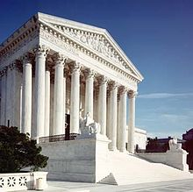
3 Separate Sovereigns
Federal
State
Tribal
United States v. Bryant, 136 S.Ct. 1954 (2016)
2

Slide 4
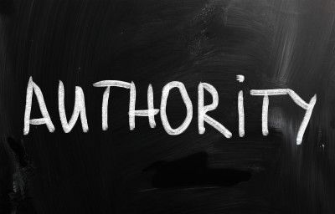
What is a Sovereign ?
Generally, an independent political community,
whose members are bound together
by being subjected to a central authority
whose commands those members must obey
Black’s Law Dictionary (11th ed. 2019)
3

Slide 5
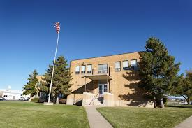
Share Education Governance
The court concludes that all three governments – federal, state and tribal – each have a duty
to educate Native children
Meyers v. Board of Education
of San Juan School District,
(D. Utah 1995)
4

Slide 6
What is Education Governance ?
Authority
Requirements & procedures
Administration & enforcement
Goals & expectations
5

Slide 7
How is Education Governed ?
Laws, regulations & policies
Agencies, entities & officials
Funding & resources
Culture & traditions
6

Slide 8
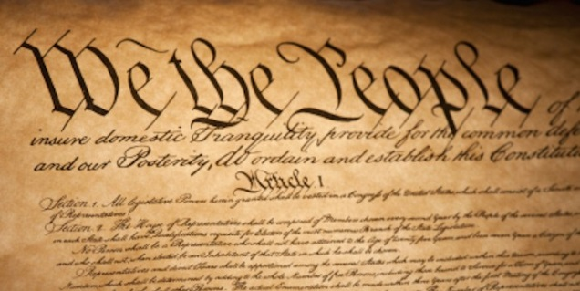
Federal & State Governance
US Constitution generally
leaves public education to states
1965 Elementary & Secondary Education Act
brings in federal requirements for resources
Federal role in public education has grown
7

Slide 9
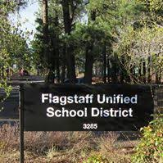
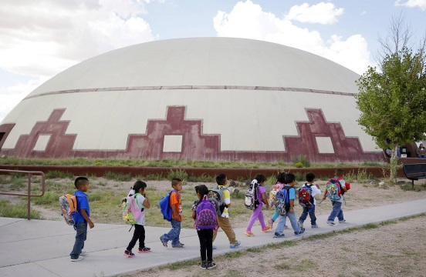
Federal & State Schools
Every state has public schools
2 Federal school systems:
Department of Defense
Department of the Interior
Bureau of Indian Education
@ 180 schools
8

Slide 10
Historical Federal Indian Education Laws & Policies
Treaty Era (1770s – 1871)
Nation-to-Nation “negotiated” legal contracts
Education provisions
In exchange for land & peace
US often contracted with churches to fulfill
Early 1800s education laws
Some appropriations
Passive-assimilationist
9

Slide 11
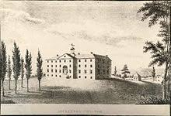
Historical Federal Indian Education Laws & Policies
Allotment & Assimilation Era (1871-1934)
Unilateral & active-assimilationist laws
Education as a means to assimilate & destroy
Federal Indian boarding schools
Increase in state public school systems
Extreme education laws
Rations withheld for school non-attendance
Unconsented Indian youth reform schools
10

Slide 12
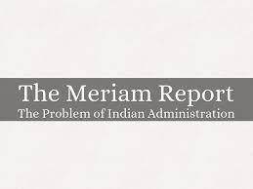
Historical Federal Indian Education Laws & Policies
New Deal Era (1920s & 1930s)
By 1912 most Native kids are in public schools
It was thought they would assimilate better
1928 Meriam Report
1934 Johnson O’Malley Act
In education, federal role reduced,
state role increased
& tribal role ignored
11

Slide 13
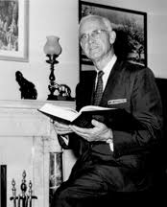
Historical Federal Indian Education Laws & Policies
Termination Era (1940s & 1950s)
Abolition or transfer
of federal role for Indians
Over 100 tribes
lost gov’t-to-gov’t relations
More federal Indian schools closed
JOM & Impact Aid subsidized state public schools
12

Slide 14
Present Federal Indian Education Laws & Policies
Self-Determination Era (1960s & 1970s)
Many new federal programs recognized tribes
1963 Vocational Education Act
1965 Elementary & Secondary Education Act
1965 Head Start program
1966 Adult Education Act
1969 Kennedy Report
recommended increased Indian control
& increased role of tribes in education
13

Slide 15
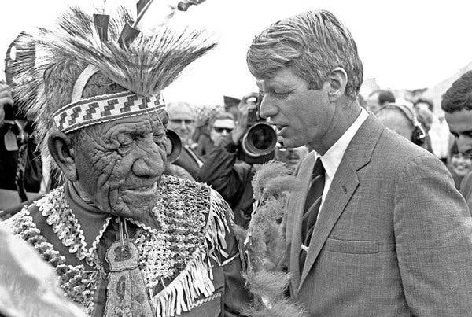
Present Federal Indian Education Laws & Policies
Self-Determination Era (1960s & 1970s)
1972 Indian Education Act
Formula grant program
(now ESSA Title VI)
Office of Indian Education
outside of BIA
NACIE
Nothing about tribal governance of education
14

Slide 16
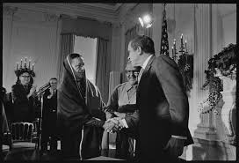
Present Federal Indian Education Laws & Policies
Self-Determination Era (1960s & 1970s)
1970 President Nixon Policy
Sovereignty over tribal Indians
is first & foremost
with their tribal governments
Federal government must support
& strengthen tribal governments
15

Slide 17
Present Federal Indian Education Laws & Policies
Self-Determination Era (1960s & 1970s)
1975 Self-Determination Act
Title I allows tribes to contract programs
& services formerly administered by
federal gov’t, including BIA schools
Title II reformed JOM to prioritize contracts
to tribes, increase state & LEA compliance, & provide for elected Indian parent committees
16

Slide 18
Present Federal Indian Education Laws & Policies
Self-Determination Era (1960s & 1970s)
1978 ESEA Re-authorization
Impact Aid IPPs require tribal participation
BIA-funded schools to develop education standards in consultation with tribes
1978 Tribally Controlled
Community College Act
17

Slide 19
Present Federal Indian Education Laws & Policies
Self-Determination Era (1980s)
1984 ESEA Reauthorization
1st mention of Tribal Education Departments
Tribes can use ‘638 funds for TEDs & Codes
1988 ESEA Reauthorization
BIA-funded school actions require
tribal consultation, & request or approval
Authorization for direct funding for TEDs
18

Slide 20
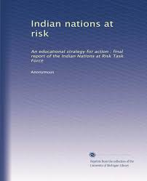
Present Federal Indian Education Laws & Policies
Self-Determination Era (1990s)
1991 Indian Nations at Risk Report
Recommends state-tribal
governmental partnerships
in public school education
1994 ESEA Reauthorization
Authorization for direct funding for TEDs through US Department of Education
19

Slide 21
Present Federal Indian Education Laws & Policies
Self-Determination Era (2000s)
2001 ESEA Reauthorization (NCLB)
Strengthened provisions for tribal accreditation of certain BIE-funded schools
Retained both TED direct funding authorizations
FY 2015 1st appropriations for TEDs
20

Slide 22
Present Federal Indian Education Laws & Policies
Self-Determination Era (2000s)
2015 ESEA Reauthorization (ESSA)
Requires states to consult with tribes
for Title I funding
Makes permanent State-Tribal
Education Partnership grant program
Requires LEAs to consult with tribes for
all funding & specifically for Formula Grants
Requires BIE to consult with tribes for Title VI
21

Slide 23
Present Federal Indian Education Laws & Policies
2015 ESSA Title I consultation requirement
Current annual appropriations
- for JOM @ < $4 million
- for IEA Formula Grants @ $100 million
- for Title I @
$16 billion
22

Slide 24
Present Federal Indian Education Laws & Policies
2015 ESSA Title I consultation requirement
Most federal laws require federal agencies
to consult with tribes
Some federal laws have optional, voluntary state-tribal partnership arrangements
No other federal law requires states to consult with tribes as a condition of getting federal $$
23

Slide 25
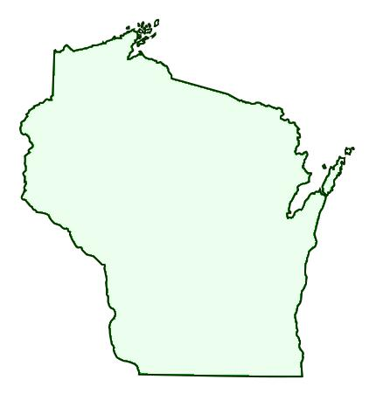
What about State Laws ?
In 1995, Wisconsin recognized TEDS
in its American Indian Language
and Culture Education Program
Wis. Stat. §115.71
24

Slide 26
What about State Laws ?
In 1999, Montana recognized TEDS
in its Indian Education for All
America Indian Studies Instruction
provisions, including in-service training
Mont. Code Ann. § 20-1-502
25

Slide 27
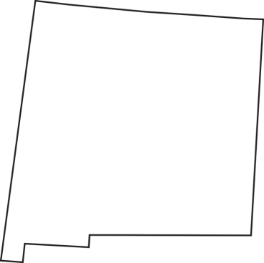
What about State Laws ?
In 2003, New Mexico recognized TEDs
in its Indian Education Act,
stating that one purpose
of the Act is to ensure that TEDs
are among those working to find ways
to improve education for Indian students
N.M. Stat. Ann. § 22-23A-2
26

Slide 28
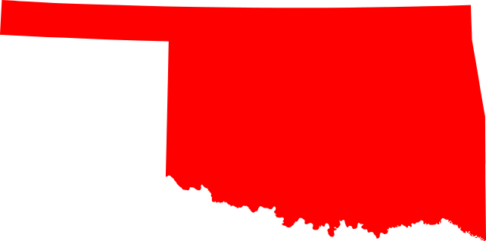
What about State Laws ?
In 2010, Oklahoma’s Advisory Council
on Indian Education included
representatives of TEDs
Okla. Stat. tit. 70 § 3.173
27

Slide 29
What about State Laws ?
In 2013, Washington became the 1st state
to authorize state-tribal compacts
in K-12 public school education
Wash. Rev. Code § 28A.715.005
28

Slide 30
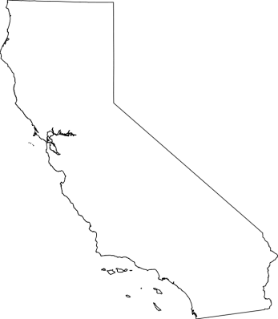
What about State Laws ?
In 2018, California became the 1st state
to legislate consultation with tribes
regarding Native studies curriculum
Cal. Educ. Code § 51226.9(a)(1)
29

Slide 31
What about State Laws ?
At least 14 states have formalized roles for tribes in their school laws or administrative codes, most often in connection with state laws allowing the teaching of tribal native languages in schools, & the certification or licensing of teachers for the languages: Arizona, California, Idaho, Michigan, Minnesota, Montana, Nebraska, Nevada, New Mexico, North Dakota, Oregon, Washington, Wisconsin, & Wyoming
30

Slide 32
Tribal Education Governance Today
Nationwide
573 federally-recognized tribes
Less than ½ have TEDs / TEAs
Even fewer have Tribal Education Codes
31

Slide 33
Tribal Education Governance Today
Washington State
5 Tribal Compact Schools:
Suquamish
Lummi
Muckleshoot
Quileute
Nisqually
http://www.k12.wa.us/IndianEd/STECs.aspx
32

Slide 34
Tribal Education Governance Today
ESSA State-Tribal Education Partnership Program
FY 2012 Grantees
Oklahoma – Chickasaw Nation
New Mexico - Dine
Idaho - Nez Perce Tribe
Oregon – Confederated Umatilla Tribes
33

Slide 35
Tribal Education Governance Today
ESSA State-Tribal Education Partnership Program
FY 2015 Grantees
Oklahoma – Muscogee Creek Nation
Oklahoma - Chickasaw Nation
Idaho - Nez Perce Tribe
Idaho - Coeur d’Alene Tribe
FY 2019 applications due August 12, 2019
34

Slide 36
What Do All the Good Laws Really Mean?
Troubling statistics
In 2016, only about 75% of AI/AN students completed high school - less than any other racial or ethnic group in the US
https://nces.ed.gov/pubs2019/2019038.pdf
In 2015, about 50% of AI/AN K-12 students reported never
being exposed to their Native languages, including in school
https://nces.ed.gov/pubsearch/pubsinfo.asp?pubid=2019048
35

Slide 37
What Do All the Good Laws Really Mean ?
Ongoing federal investigation
U.S. Department of Education’s Office of Civil Rights
investigating alleged discrimination of Native students
in Wolf Point School District, Montana
(Ft. Peck Indian Reservation)
Unequal treatment, push outs, discipline,
harassment, retaliation, &
deprivation of basic due process rights
In 2010, 6 Native students committed suicide;
another 20 attempted
https://www.aclumontana.org/sites/default/files/field_documents/fort_peck_reservation_
title_vi_doj_complaint.pdf
36

Slide 38
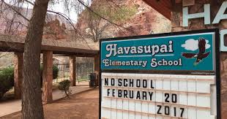
What Do All the Good Laws Really Mean ?
Pending federal court case (Stephen C., et al. v. BIE)
Havasupai Elementary School (K-8)
Allegations
Failure to provide basic instruction
Only minimal instruction in Native language
Non-compliant library
No extracurricular activities
Disabled students ignored or mistreated
37

Slide 39
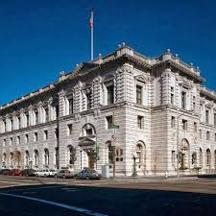
Can Tribes Govern State Public Schools?
US Court of Appeals for the Ninth Circuit
Possibly, where schools are on tribal land
Window Rock Unified School Dist. v. Reeves,
861 F.3d 894 (9th Cir. 2017)
US Court of Appeals for the Eighth Circuit
Very unlikely
Fort Yates Public School Dist. v. Murphy,
786 F.3d 662 (8th Cir. 2015)
38

Slide 40
Will the US ever Properly Manage Indian Education?
US GAO, Further Actions on GAO Recommendations
Needed to Address Systemic Management Challenges
with Indian Education (April 2015)
https://www.gao.gov/assets/670/669784.pdf
US GAO, Further Actions Needed to Improve Oversight
and Accountability for [BIE] School Safety Inspections (May 2017)
https://www.gao.gov/products/GAO-17-421
39

Slide 41
What Can be Done about Attendance & Language?
US GAO, Public School Choice: Limited Options Available
for Many AI/AN Students (January 2019)
https://www.gao.gov/assets/670/669784.pdf
In 2015, Oklahoma became the 1st state to authorize
tribes to charter directly state public schools
Okla. Stat. tit. 70 § 3-132
40

